Slide 1
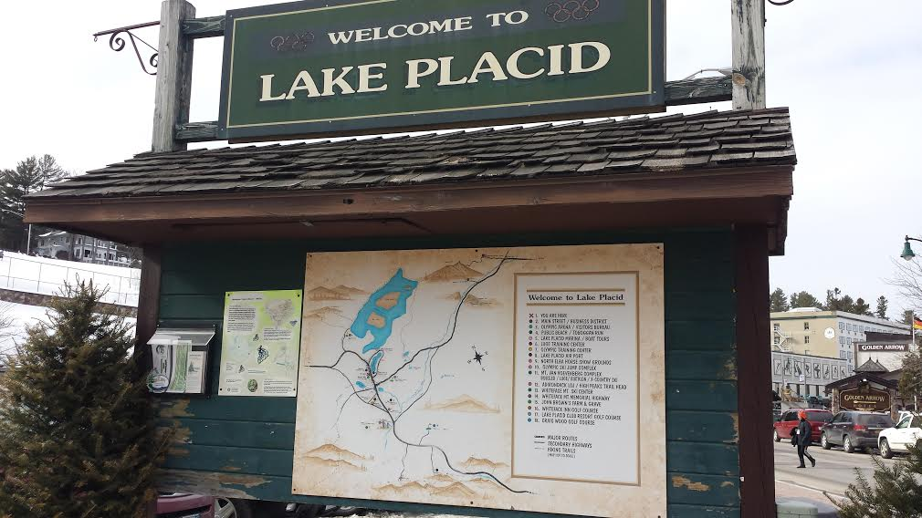
Lake Placid/North Elba Trail Connections
Cornell Institute for Public Affairs Spring 2015 Consulting Project
May 11, 2015
Devin Martin, Allison Springer & Yuexi Zheng

Slide 2
Thank You
Laurie Miller, Carrie Young
Shanika Perera, Bobby Toth
Dean Dietrich
Julie Ball
Development Commission
Olympic Training Center
Raymond Curran, Jeff Erenstone, Tony Goodwin, Jeff Graff, Vinny McClelland, Ezra Schwartzberg, Josh Wilson
Village Beach House
Lake Placid/North Elba Community
City and Regional Planning GIS Staff

Slide 3
Project Overview
2014 Comprehensive Plan
Cornell Institute for Public Affairs (CIPA) Consulting Program
Two primary deliverables
Map of the area that shows connection points
Report of findings from research and qualitative interviews

Slide 4
Presentation Overview
Case Study Analysis
Stakeholder Engagement
Geographic Informational Systems (GIS) Analysis

Slide 5
Case Study Analysis

Slide 6
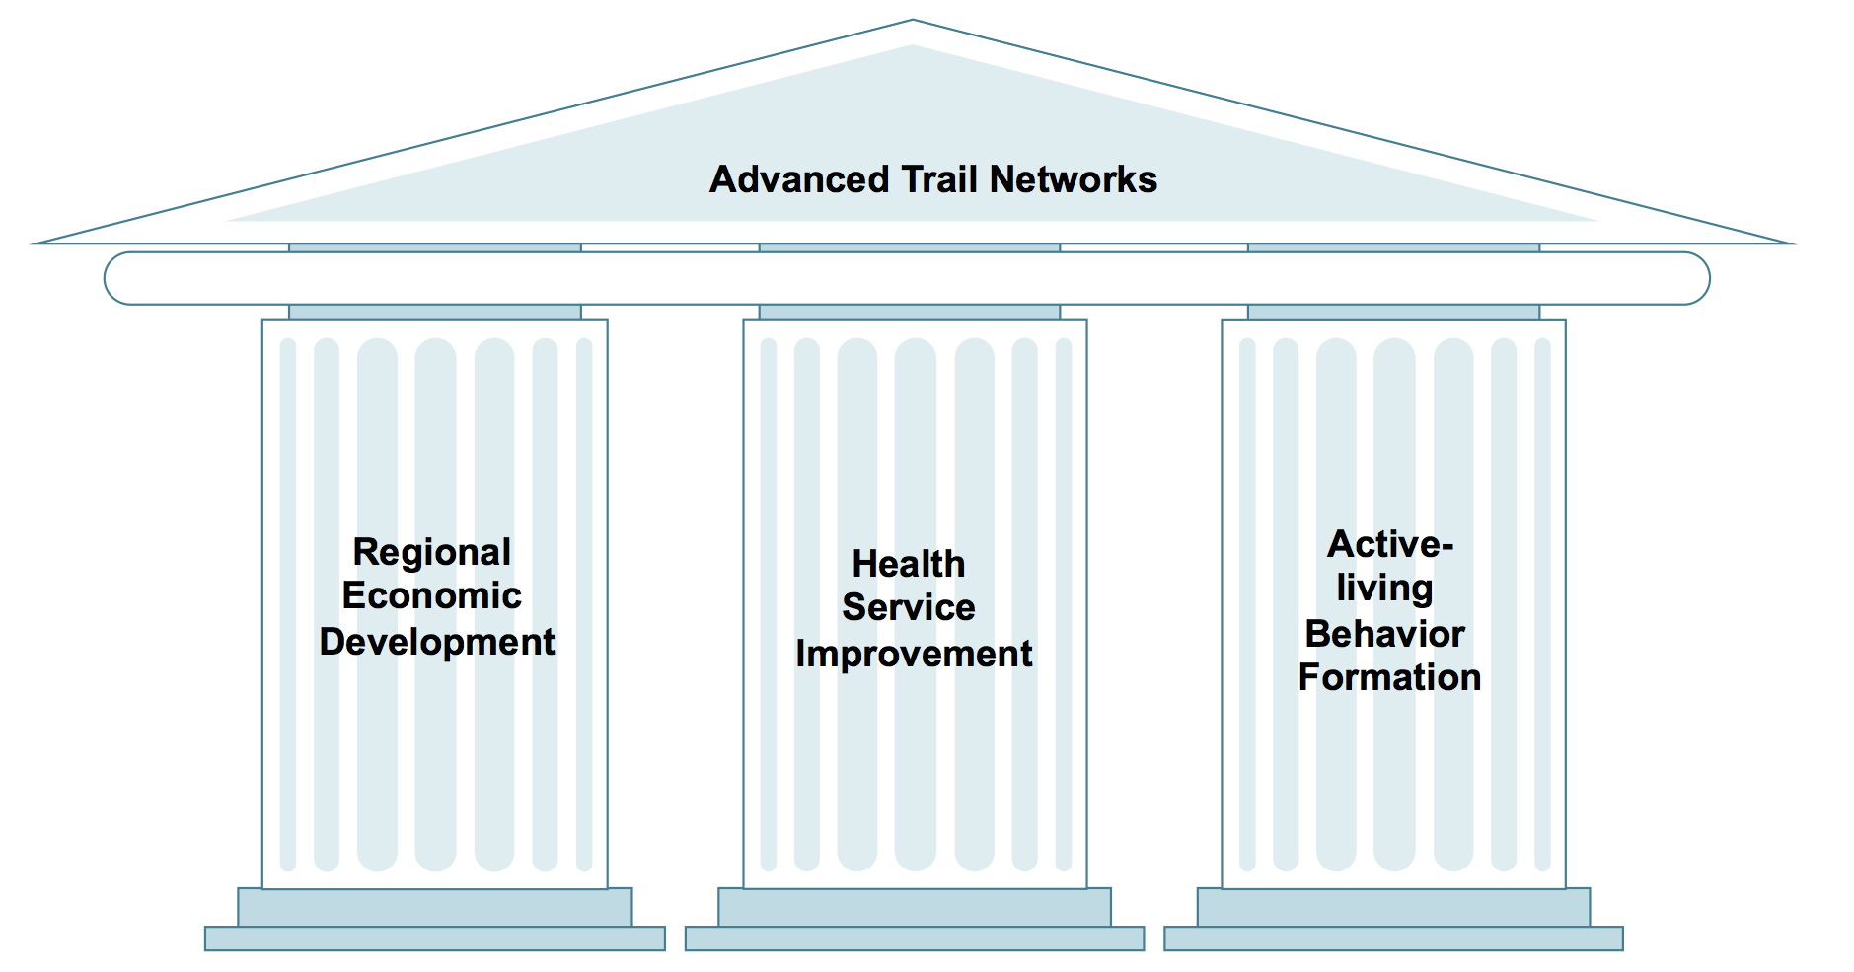
Literature Review: Case Study Analysis

Slide 7
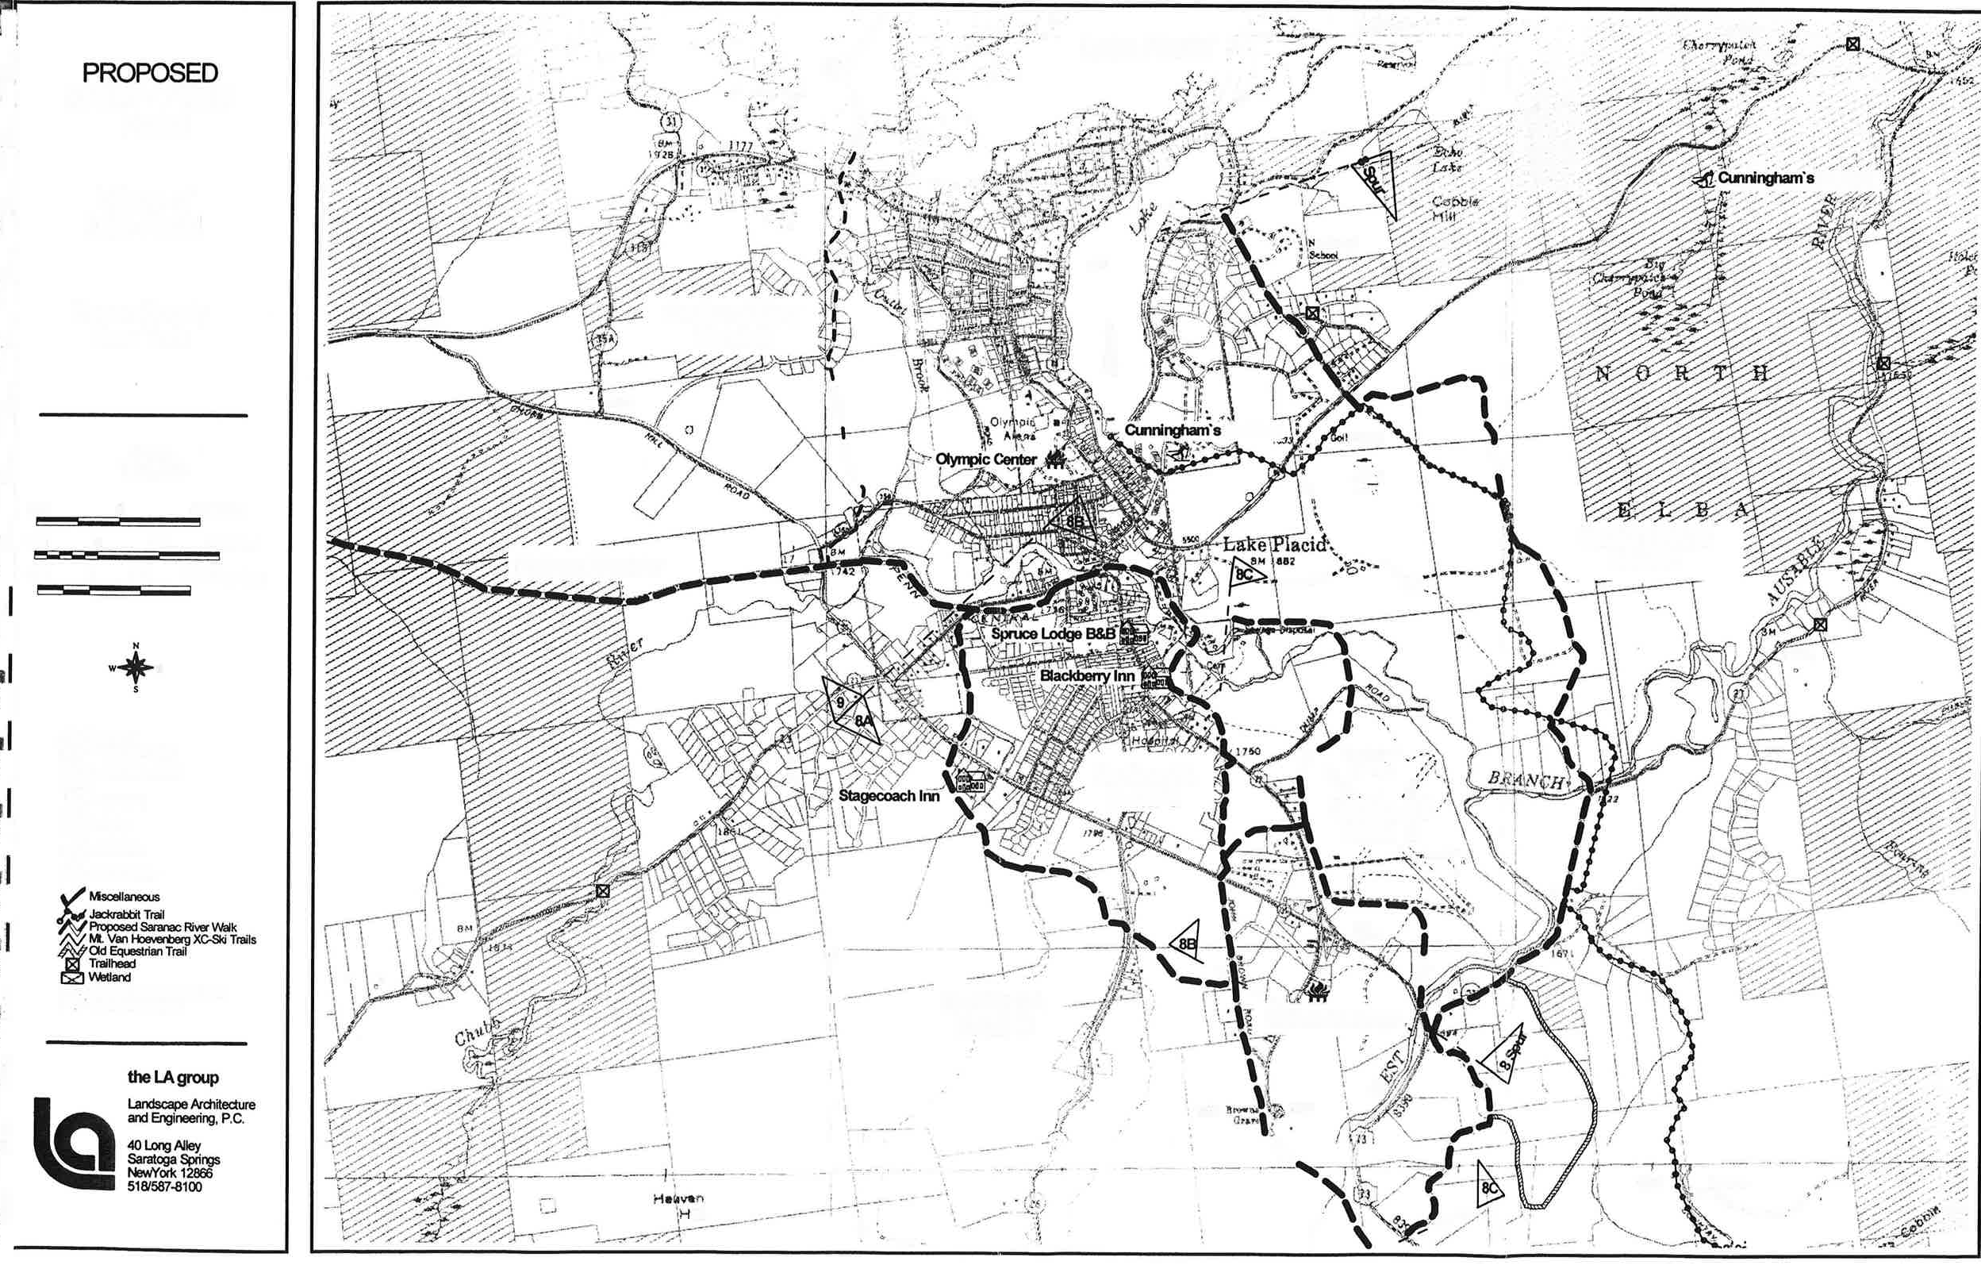
Safety Path Plan, Adirondacks, NY
Safety Path Plan Project Overview
Useful comprehensive project scope
Project feasibility study phase
Follow-up study phase

Slide 8
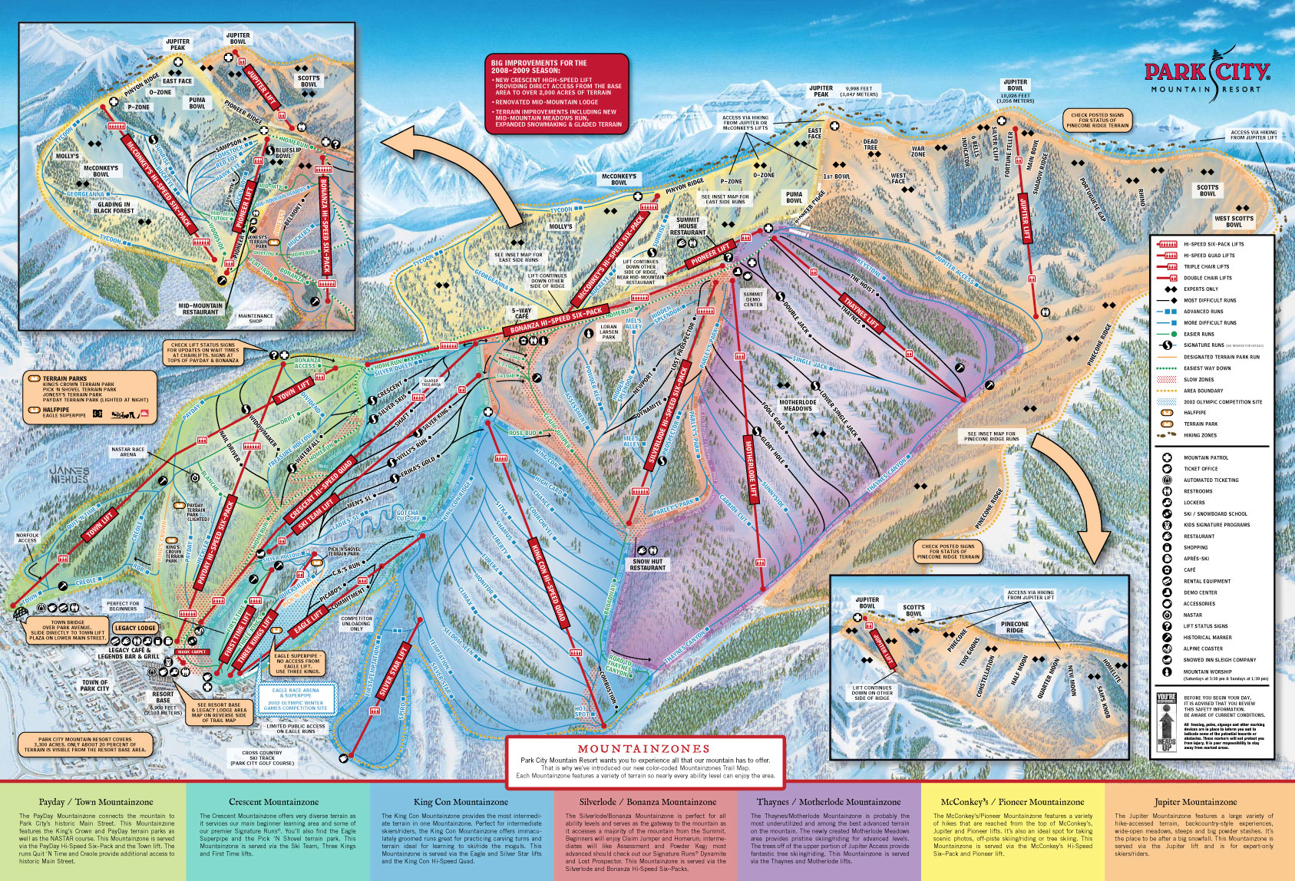
Park City Trails Master Plan, Park City, Utah
Park City Trail Plan Project Overview
Public involvement
Environmentally sensitive sites
American Disability Act

Slide 9
Crested Butte Gunnison County Trails Master Plan, Gunnison County, CO
Crested Butte Trail Plan Project Overview
Broad mix of trail types
Project selection criteria
Method to summarize project results

Slide 10
Recommendations based on Case Studies
1. Get more public involved in Lake Placid Trail Connection Project by survey or other forms to know more about local residents' opinions.
2. Pay attention to environmentally sensitive sites when choosing the connection points.
3. Include considerations for the disabled to comply with American Disability Act when plan and design the trails.
4. Add per linear foot cost estimates step before making trail connection recommendations.
5. When coming to construction phase, pay attention to different types of trails, surface material choice, road sign design and so forth.
6. For the long-term construction, learn effective fundraising strategies.

Slide 11
Stakeholder Engagement

Slide 12
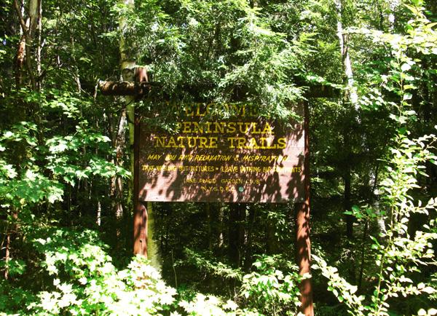
Literature Review: Stakeholder Engagement
Open Source Branding
Consensus Building

Slide 13
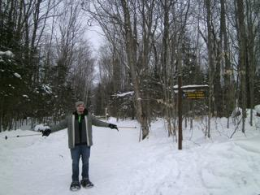
Qualitative Stakeholder Interviewing
Lake Placid site visit, 3/19-3/21
Gathered data from interviews
Interview participants
Questions
Organizational overview
Trail integrations/connections
Trail access
Example trail models

Slide 14
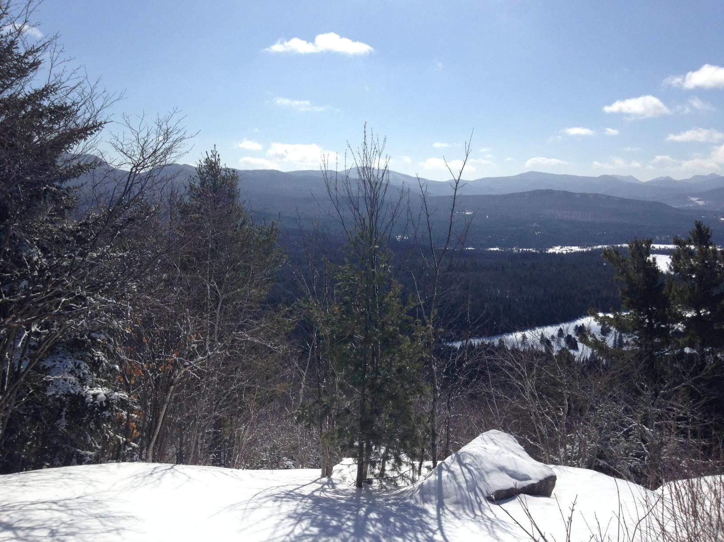
Qualitative Interviews
Information sharing: Bridle paths, maps, stewardship
Foot traffic along roads
Safety path plan
Trailhead location
Local businesses
Recommendations to observe
outside trail networks
Trail unit management plan

Slide 15
Recommendations from Qualitative Interviews
Creation of a community forum in which interested parties can meet to discuss trail-related projects, as well as share information regarding future connections.
Creation of a community file-sharing drive in which interested parties can share information related to trail systems.

Slide 16
GIS Analysis

Slide 17
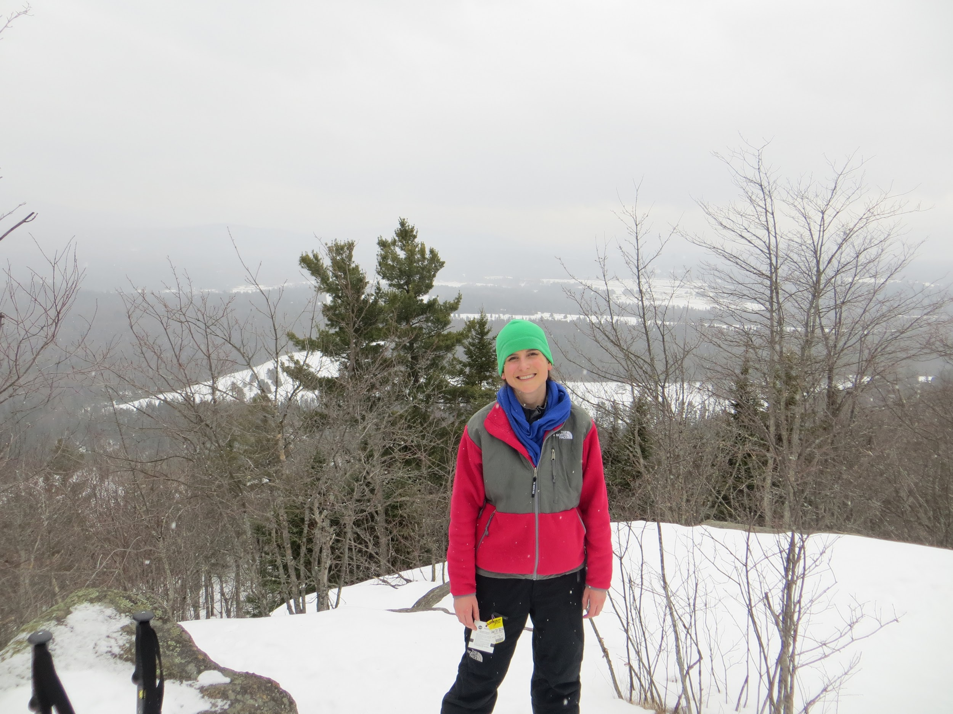
Literature Review: GIS Analysis
Role of GIS in field of planning
Environmental considerations
Respect for natural corridors
Topography
Land use classifications
Potential barriers

Slide 18
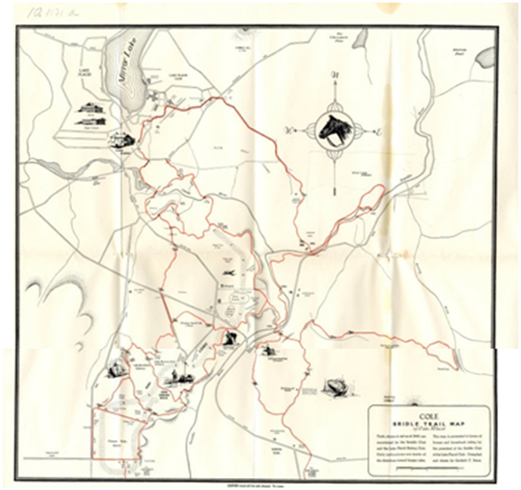
GIS Data
GIS learning curve and limitations within the team
Cornell University Geospatial Information Repository (CUGIR)
Adirondack Park Agency Data
Municipal boundaries
Topography
Mapping trails in the area
Differences in scale and quality
eg. Bridle Trail Map
Hand-drawn map limitations
Bridle Trail Map

Slide 19
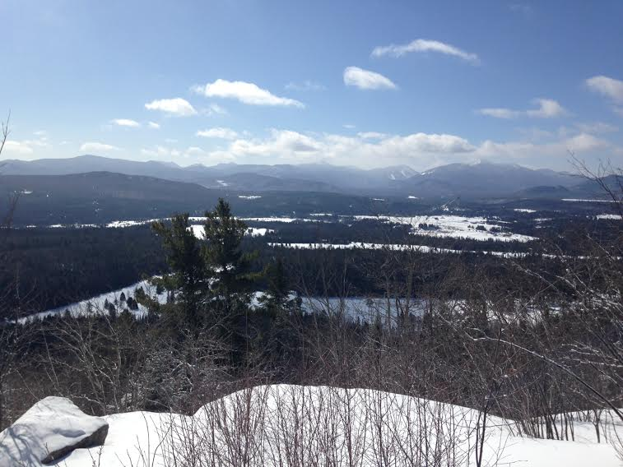
GIS Analysis
Cobble Hill Southern Perspective of Lake Placid/North Elba

Slide 20
Adirondack Park Agency Land Classifications: Property/Developed
Hamlet: Growth and service centers of the Park where the Agency encourages development.
Moderate Intensity Use: Most uses are permitted. Concentrated residential development.
Low Intensity Use: Most uses are permitted. Residential development is lower than hamlet or moderate intensity.
Rural Use: Residential uses and reduced intensity development that preserves rural character is most suitable.
Resource Management: Permits required. Uses include residential, agriculture, and forestry. Protect the natural open space character of the land in this class.
Industrial Use: Where industrial uses exist or areas that may be suitable for future industrial development. Industrial and commercial uses are allowed in other land classifications.

Slide 21
Adirondack Park Agency Land Classifications: State Land
Wilderness: Area of state land or water having a primeval character, without significant improvement or permanent human habitation, which is protected and managed so as to preserve, enhance, and restore its natural conditions.
Primitive: Area of land or water that is essentially wilderness in character but contains structures that are inconsistent with wilderness or private lands that prevent wilderness status.
Canoe: Area where the watercourses or the number and proximity of lakes and ponds make possible a remote and unconfined type of water-oriented recreation in an essentially wilderness setting.
Wild Forest: Area where the resources permit a somewhat higher degree of human use than in wilderness, primitive or canoe areas, while retaining an essentially wild character. Lacks a sense of remoteness and permits a wide variety of outdoor recreation.
Intensive Use: Area where the state provides facilities for intensive forms of outdoor recreation by the public. Two types of intensive use areas are campground and day-use areas.
Historic: Locations of buildings, structures, or sites owned by the state that are significant in the history, architecture, archeology or culture of the Adirondack Park, the state or nation.
State Administrative: Areas there the state provides facilities for a variety of specific state purposes that are not primarily designed to accommodate visitors to the park.

Slide 22
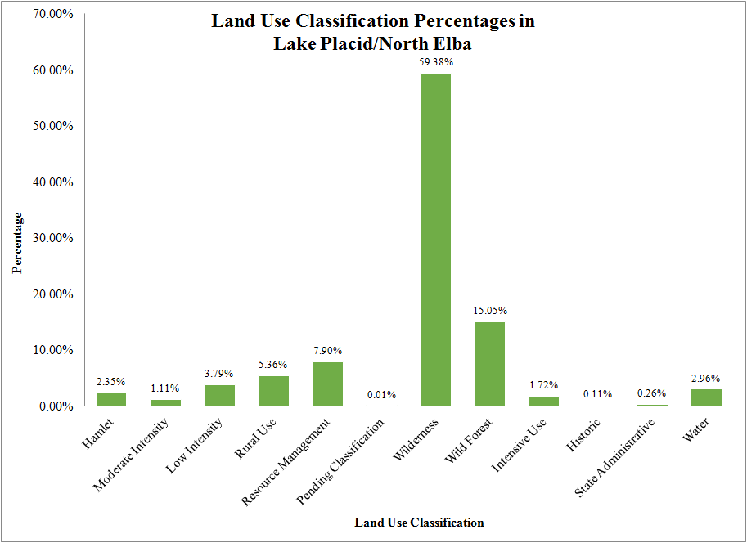

Slide 23
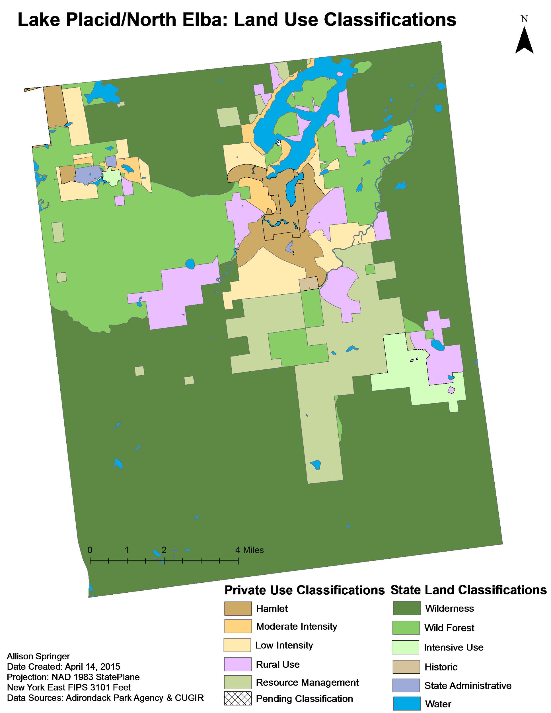

Slide 24
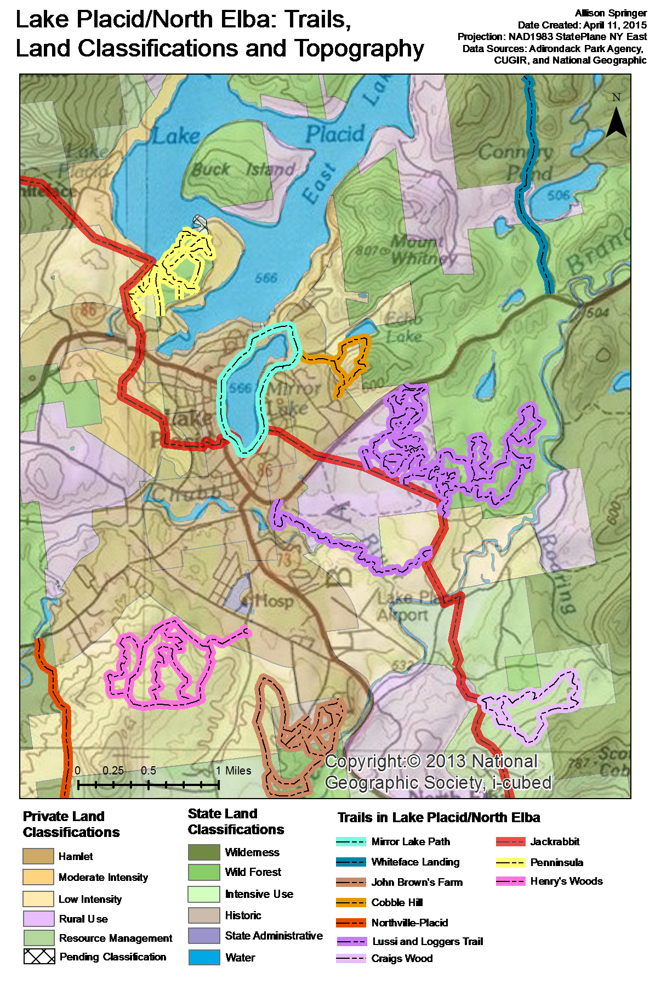

Slide 25
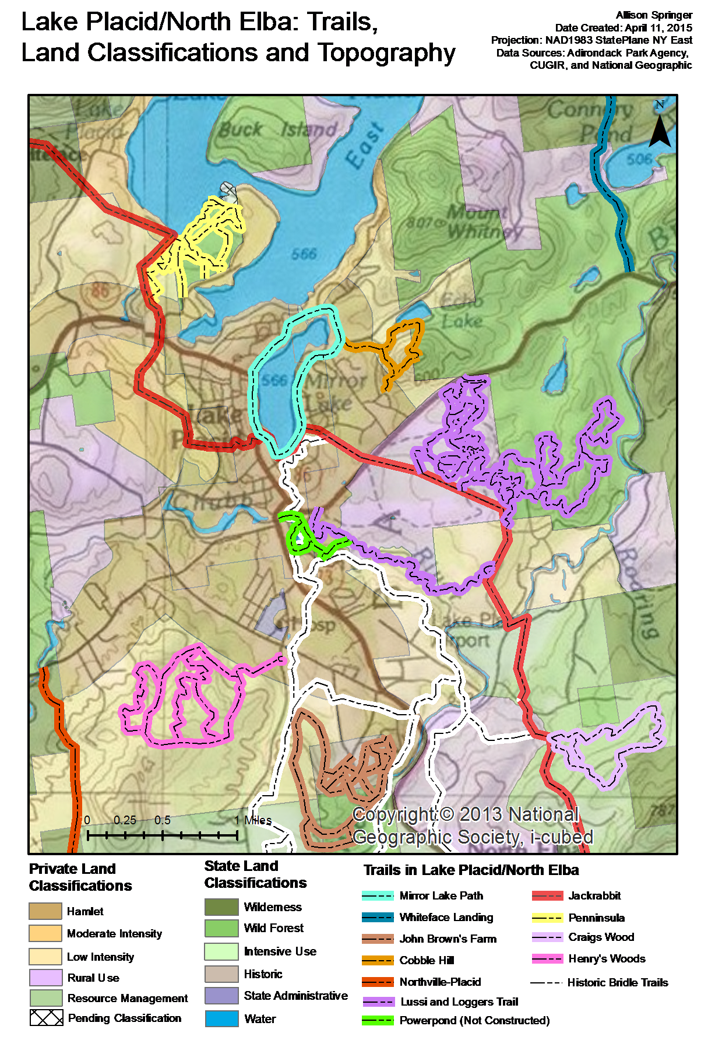

Slide 26
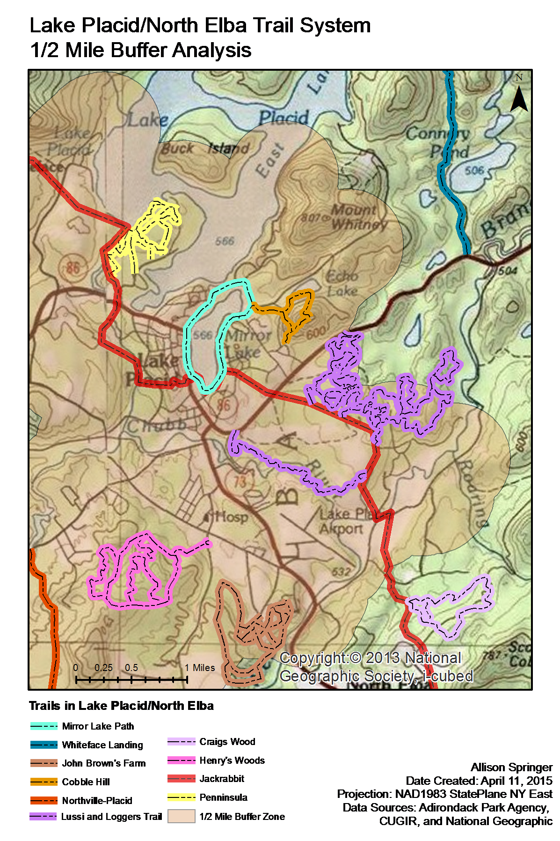

Slide 27
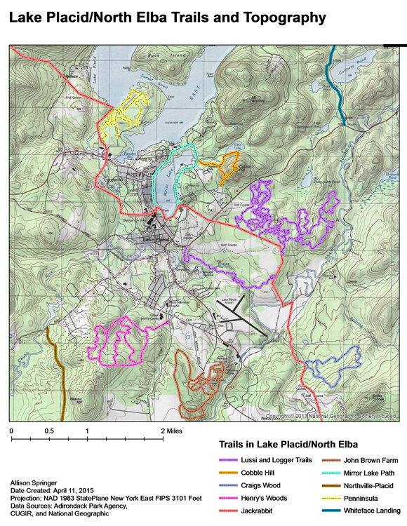

Slide 28
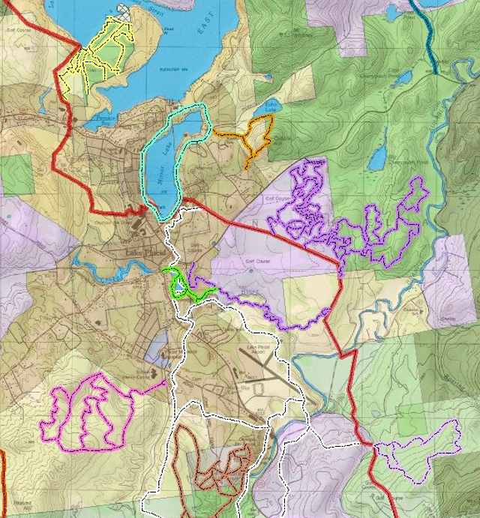
GIS Recommendations
Powerpond Trail as a centralized connection point.

Slide 29
GIS Recommendations
2. The Bridle Trails should be evaluated and assessed on the ground to determine viability for use for trail linkages.

Slide 30
GIS Recommendations
3. Manually GPS the trails in Lake Placid/North Elba to create accurate distance shapefiles to be used to create future mapping products.
4. Connection between Henry’s Woods and Northville-Placid trail has potential for future development based on the development plans determined by the Uihlein Foundation.
5.Create a tourism or marketing pamphlet with the consumer map, individual trail maps, and descriptions provided by trail management experts.

Slide 31
Questions?

Slide 32
Thank You!
Devin Martin
dtm94@cornell.edu
Allison Springer
ajs623@cornell.edu
Yuexi Zheng
yz797@cornell.edu

